Slide 1
ITSA線上程式競賽基礎題目
#16~20

Slide 2
題目16. 子字串出現次數
https://e-tutor.itsa.org.tw/e-Tutor/mod/programming/view.php?id=30768
運算思維: (課堂講解)
程式碼說明: (課堂講解)

Slide 3
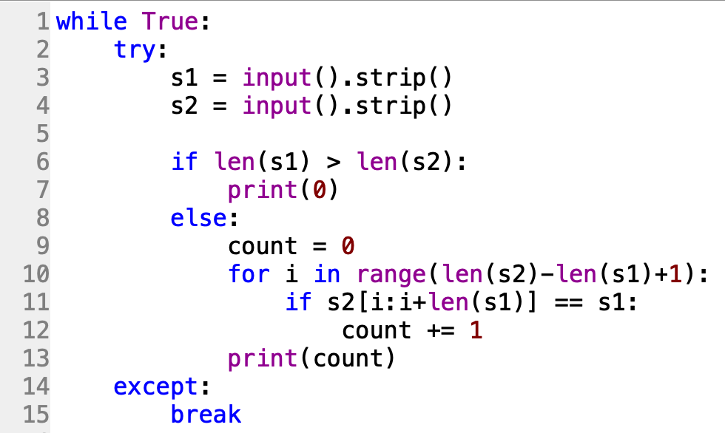
baba
12b3bbababa12

Slide 4
題目17. 英文斷詞
https://e-tutor.itsa.org.tw/e-Tutor/mod/programming/view.php?id=30769
運算思維: (課堂講解)
程式碼說明: (課堂講解)

Slide 5
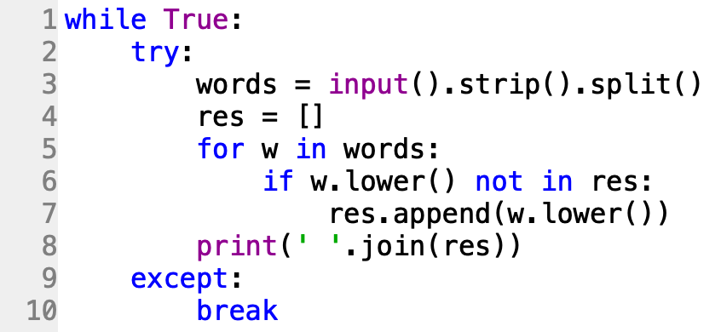

Slide 6
題目18. QWERTY
https://e-tutor.itsa.org.tw/e-Tutor/mod/programming/view.php?id=30764
運算思維: (課堂講解)
程式碼說明: (課堂講解)

Slide 7
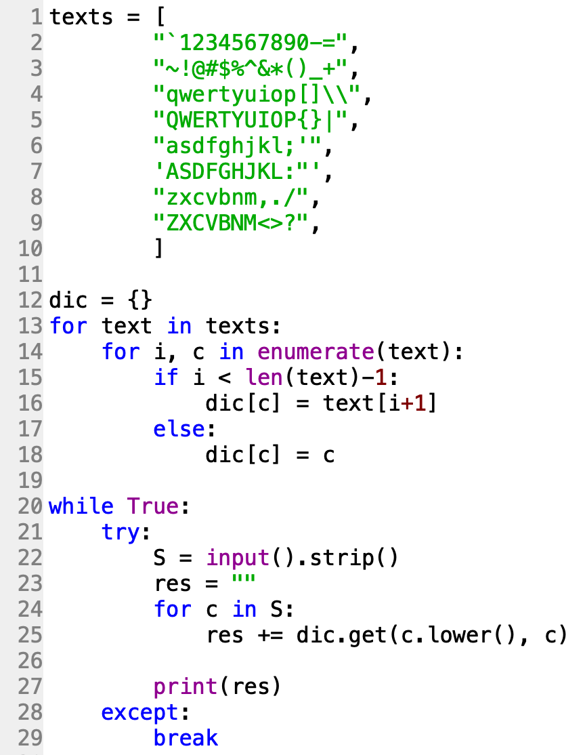

Slide 8
題目19. 最少派車數
https://e-tutor.itsa.org.tw/e-Tutor/mod/programming/view.php?id=30777
運算思維: (課堂講解)
程式碼說明: (課堂講解)

Slide 9
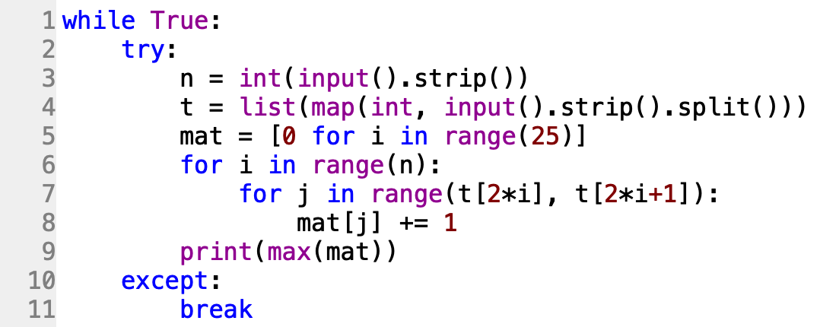
0 | 1 | 2 | 3 | 4 | 5 | 6 | 7 | 8 | 9 | 10 | 11 | 12 | 13 | 14 | 15 | 16 | 17 | 18 | 19 | 20 | 21 | 22 | 23 | 24
0 | 0 | 0 | 0 | 0 | 0 | 0 | 0 | 0 | 0 | 0 | 0 | 0 | 0 | 0 | 0 | 0 | 0 | 0 | 0 | 0 | 0 | 0 | 0 | 0
0 | 1 | 1 | 1 | 1 | 1 | 0 | 0 | 0 | 0 | 0 | 0 | 0 | 0 | 0 | 0 | 0 | 0 | 0 | 0 | 0 | 0 | 0 | 0 | 0
0 | 1 | 1 | 2 | 2 | 2 | 1 | 1 | 1 | 1 | 1 | 1 | 0 | 0 | 0 | 0 | 0 | 0 | 0 | 0 | 0 | 0 | 0 | 0 | 0
0 | 1 | 1 | 2 | 2 | 2 | 2 | 2 | 2 | 2 | 2 | 2 | 1 | 1 | 1 | 1 | 1 | 1 | 0 | 0 | 0 | 0 | 0 | 0 | 0

Slide 10
題目20. 大整數加法
https://e-tutor.itsa.org.tw/e-Tutor/mod/programming/view.php?id=30783
運算思維: (課堂講解)
程式碼說明: (課堂講解)

Slide 11
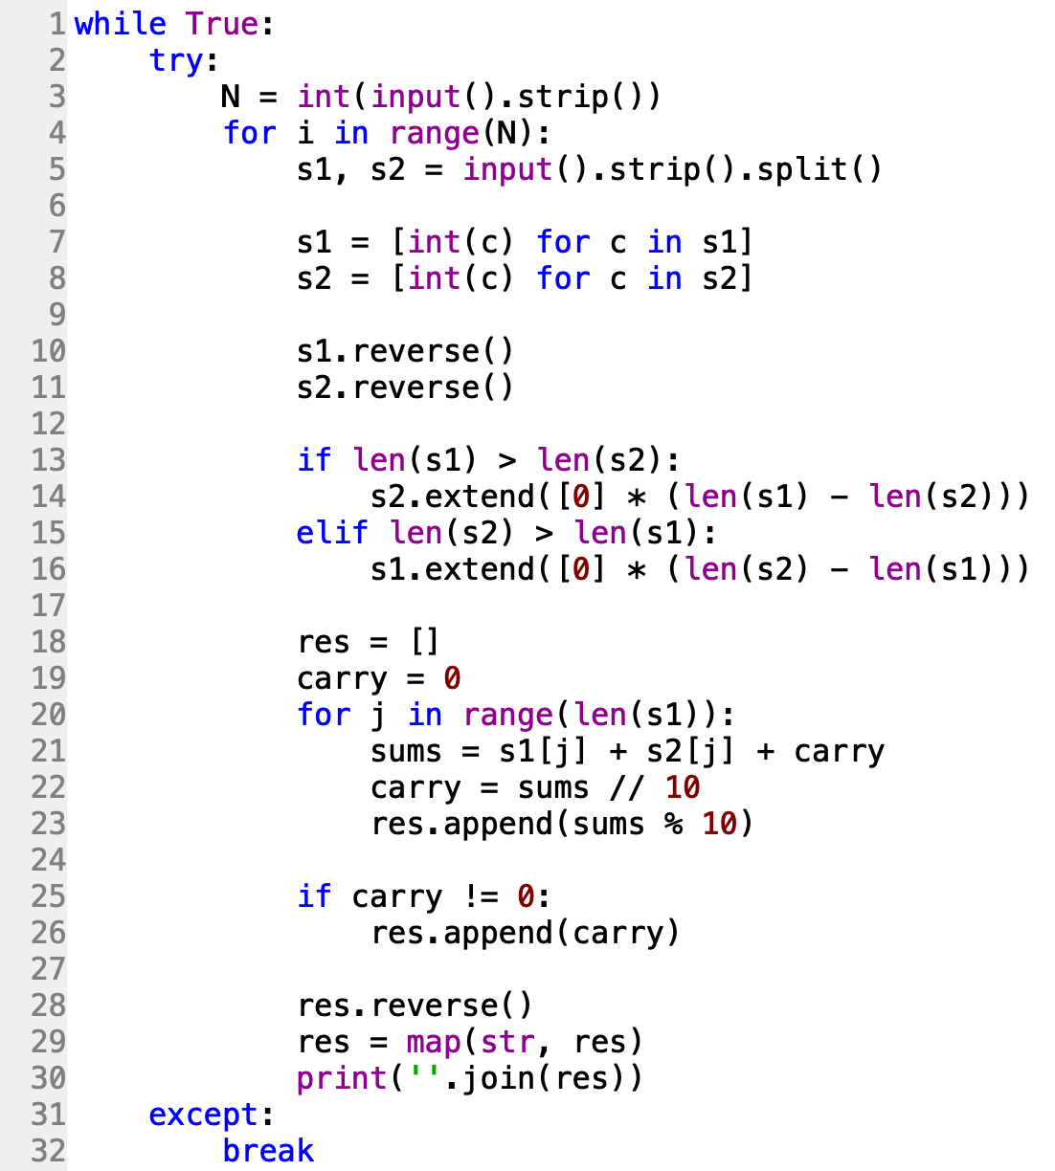
3 | 4 | 5 | 6
 | 7 | 8 | 9
3 | 4 | 5 | 6
7 | 8 | 9
6 | 5 | 4 | 3
9 | 8 | 7 | 0
6 | 5 | 4 | 3
9 | 8 | 7 | 0
5
 | 1

